Slide 1
Literal Equations
Algebra I | Module 3 | Topic 1 | Lesson 2
1
Notes:
Note: Total suggested pacing for this lesson is two 45-minute sessions.

Slide 2
Objectives
Rewrite linear equations in different forms.
Analyze the structure of different forms of linear equations.
Recognize and use literal equations.
Rearrange literal equations to highlight quantities of interest.
SE p. 357
2
Notes:
TEKS:
A.1A: apply mathematics to problems arising in everyday life, society, and the workplace.
A.1D: communicate mathematical ideas, reasoning, and their implications using multiple representations, including symbols, diagrams, graphs, and language as appropriate.
A.2B: write linear equations in two variables in various forms, including y = mx + b, Ax + By = C, and y – y₁ = m(x – x₁), given one point and the slope and given two points.
A.3A: determine the slope of a line given a table of values, a graph, two points on the line, and an equation written in various forms, including y = mx + b, Ax + By = C, and y – y₁ = m(x – x₁).
A.12E: solve mathematic and scientific formulas, and other literal equations, for a specified variable.
ELPS:
3A: practice producing sounds of newly acquired vocabulary such as long and short vowels, silent letters, and consonant clusters to pronounce English words in a manner that is increasingly comprehensible.
4D: use prereading supports such as graphic organizers, illustrations, and pretaught topic-related vocabulary and other prereading activities to enhance comprehension of written text.
4J: demonstrate English comprehension and expand reading skills by employing inferential skills such as predicting, making connections between ideas, drawing inferences and conclusions from text and graphic sources, and finding supporting text evidence commensurate with content area needs.

Slide 3
Key Terms (1 of 1)
literal equation [ecuación literal]: Literal equations are equations in which the variables represent specific measures
Example
  The equations I = Prt and A = lw are literal equations.
SE p. 357
3
Notes:
Note: Literal equation is introduced on Day 1.

Slide 4
Essential Question (1 of 2)
You have used different properties to solve linear equations to determine which value makes the equation true.
How can you use those same properties to solve for one specific variable in an equation that has multiple variables?
SE p. 357
4
Notes:
Setting the Stage:
Tap into your student’s prior learning by reading the narrative statement.
Provide a sense of direction by reading the Essential Question.

Slide 5
Day 1
1
5
Notes:
Note: Total suggested pacing for Day 1 is 45 minutes.

Slide 6
Getting Started
★ Essential activity: do not skip
15
6
Notes:
Note: Total time of 15 minutes allotted for the Getting Started.

Slide 7
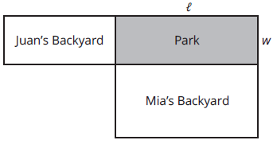
Perimeter Perspectives (1 of 6)
Juan and Mia have rectangular backyards that each share a side with a neighborhood park. The sides shared with the park are adjacent to each other as shown.
★ Essential · SE p. 358
7

Slide 8
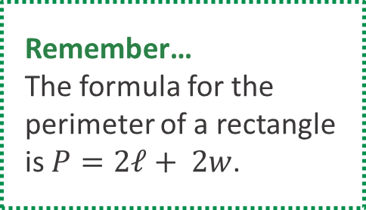
Perimeter Perspectives (2 of 6)
Juan and Mia are each responsible for constructing their own fence to separate their yard from the park. The city gives them the measure of the perimeter of the park in feet. So that each knows how much fencing to buy, Juan needs to determine the width of the park, and Mia needs to determine the length of the park.
Remember…
The formula for the
perimeter of a rectangle
is $P=2ℓ+ 2w$.
★ Essential · SE p. 358
8

Slide 9
Perimeter Perspectives (3 of 6)
How can you write an equation for the perimeter of the park from each person’s perspective to help them determine the information they need?
  Juan: w = P/2 − ℓ. Mia: ℓ = P/2 − w. Each solves P = 2ℓ + 2w for the side they need.
★ Essential · SE p. 358
9
Notes:
Questions to Support Discourse – Gathering:
Why does Juan need to determine the park’s width?
Was it more difficult to solve this equation than previous equations? Why or why not?
Questions to Support Discourse – Probing:
Explain your steps to isolate the variable w.
What properties did you apply to solve for w?
How can you show both equations are equivalent to the perimeter equation?
Questions to Support Discourse – Seeing Structure:
How does the expression $\frac{1}{2}$ P – l relate to the diagram?
Questions to Support Discourse – Reflecting and Justifying:
Why does it make sense to show both equations are equivalent to the perimeter equation?

Slide 10
Perimeter Perspectives (4 of 6)
Show that the two equations are equivalent.
  Multiply each by 2: 2w = P − 2ℓ and 2ℓ = P − 2w. Both rearrange to 2ℓ + 2w = P.
★ Essential · SE p. 358
10
Notes:
Questions to Support Discourse – Gathering:
Why does Juan need to determine the park’s width?
Was it more difficult to solve this equation than previous equations? Why or why not?
Questions to Support Discourse – Probing:
Explain your steps to isolate the variable w.
What properties did you apply to solve for w?
How can you show both equations are equivalent to the perimeter equation?
Questions to Support Discourse – Seeing Structure:
How does the expression $\frac{1}{2}$ P – l relate to the diagram?
Questions to Support Discourse – Reflecting and Justifying:
Why does it make sense to show both equations are equivalent to the perimeter equation?

Slide 11

Perimeter Perspectives (5 of 6)
Let’s summarize our learning from the Getting Started!
★ Essential · SE p. 358
11
Notes:
Getting Started Summary:
A formula involving more than one variable can be rewritten in an equivalent form to solve a problem situation.

Slide 12
Perimeter Perspectives (6 of 6)
★ Essential · SE p. 358
12
Notes:
Note: This slide is blank for optional use with displaying work.

Slide 13
Activity 2.1
★ Essential activity: do not skip
2.1
25–30
13
Notes:
Note: Total time of 25-30 minutes allotted for Activity 2.1.

Slide 14
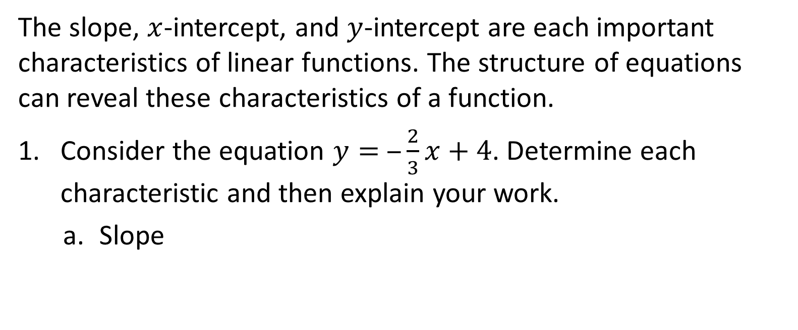
Equations in Different Forms (1 of 13)
The slope, $x$-intercept, and $y$-intercept are each important characteristics of linear functions. The structure of equations can reveal these characteristics of a function.
Consider the equation $y= ‒\frac{2}{3}x+4$. Determine each characteristic and then explain your work.
  Slope
    −2/3
★ Essential · SE p. 359
14
Notes:
Questions to Support Discourse – Probing:
Which characteristics of the linear function were apparent from the equation?
How did you determine the x-intercept? How was your strategy related to the meaning of the x-intercept?

Slide 15
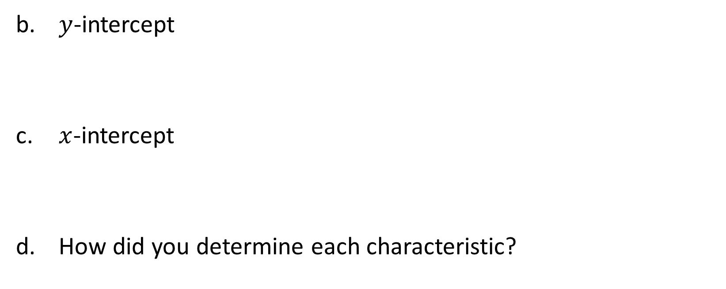
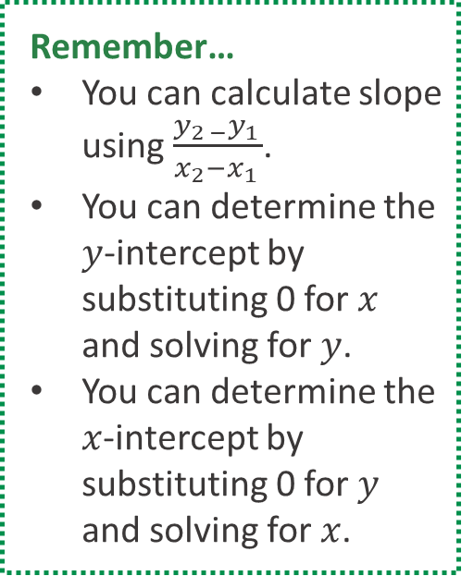
Equations in Different Forms (2 of 13)
$y$-intercept
  (0, 4)
$x$-intercept
  (6, 0)
How did you determine each characteristic?
  Slope and y-intercept come straight from y = mx + b. For the x-intercept, substitute 0 for y and solve.
Remember…
You can calculate slope using $\frac{y_{2 −}y_{1 }}{x_{2}−x_{1 }}$.
You can determine the $y$-intercept by substituting 0 for $x$ and solving for $y$.
You can determine the $x$-intercept by substituting 0 for $y$ and solving for $x$.
★ Essential · SE p. 359
15
Notes:
Questions to Support Discourse – Probing:
Which characteristics of the linear function were apparent from the equation?
How did you determine the x-intercept? How was your strategy related to the meaning of the x-intercept?

Slide 16
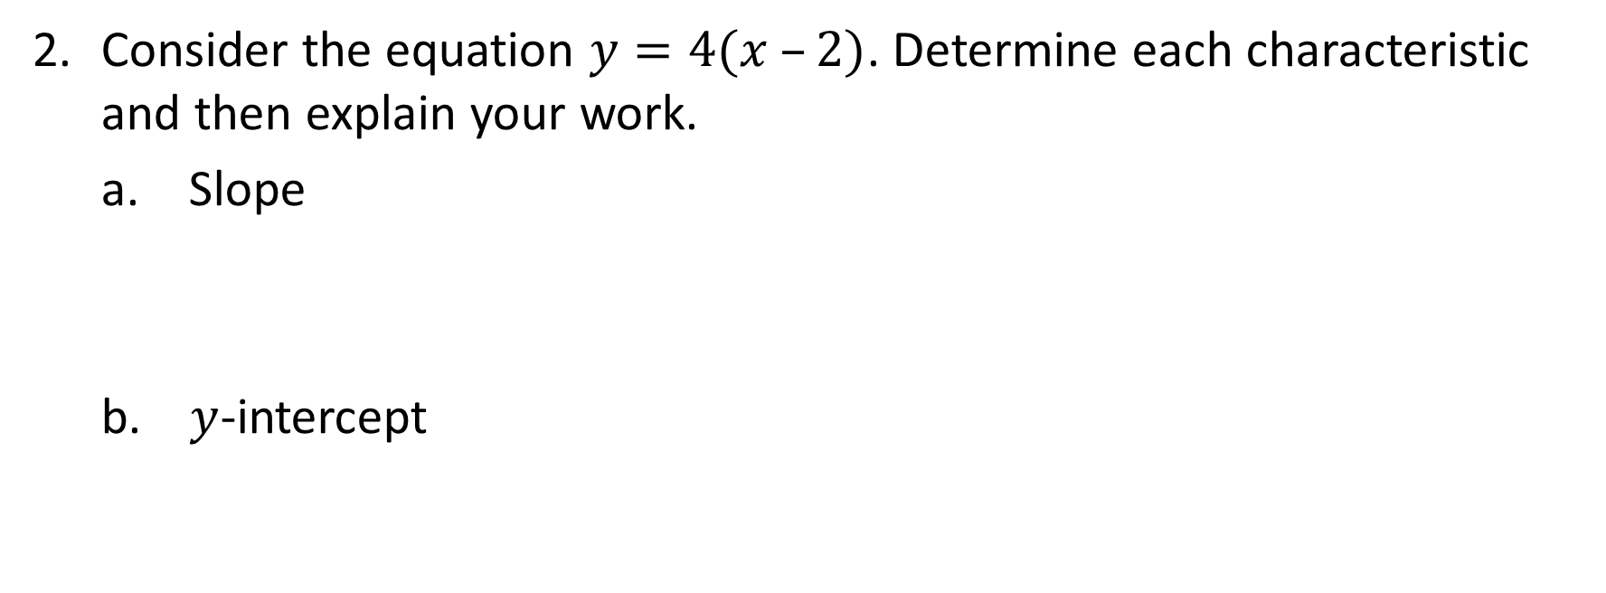
Equations in Different Forms (3 of 13)
Consider the equation $y=4(x –2)$. Determine each characteristic and then explain your work.
Slope
  4
$y$-intercept
  (0, −8)
★ Essential · SE p. 359
16
Notes:
Questions to Support Discourse – Probing:
Explain how you determined the value of each characteristic.
Questions to Support Discourse – Seeing Structure:
Use substitution to show why the x-intercept is (2, 0).
How can you use the structure of the equation to identify the x-intercept?

Slide 17
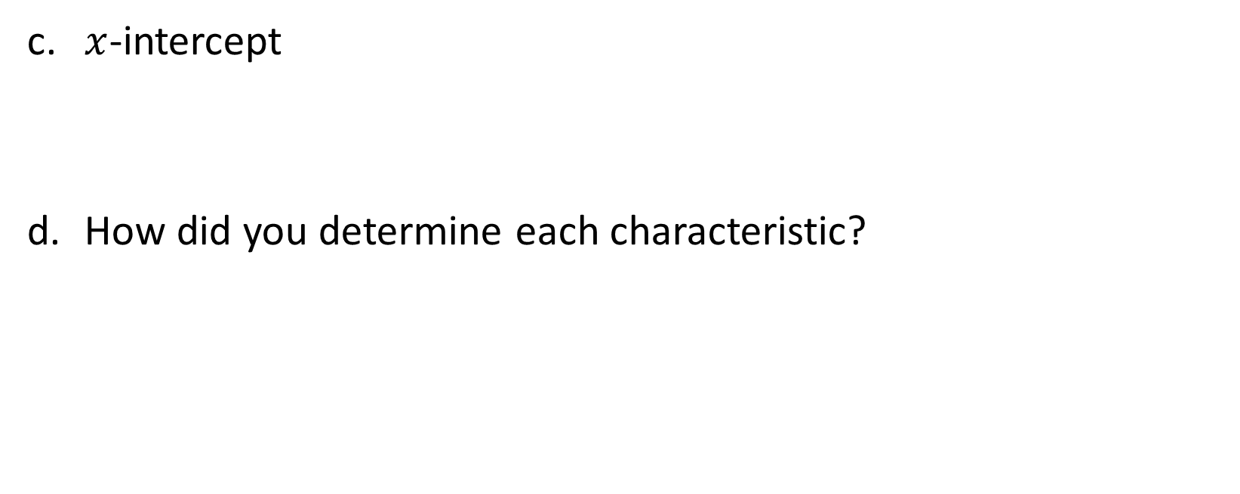
Equations in Different Forms (4 of 13)
$x$-intercept
  (2, 0)
How did you determine each characteristic?
  The slope and x-intercept come from the equation (x − 2 = 0 at x = 2). Distribute, y = 4x − 8, for the y-intercept.
★ Essential · SE p. 359
17
Notes:
Questions to Support Discourse – Probing:
Explain how you determined the value of each characteristic.
Questions to Support Discourse – Seeing Structure:
Use substitution to show why the x-intercept is (2, 0).
How can you use the structure of the equation to identify the x-intercept?

Slide 18
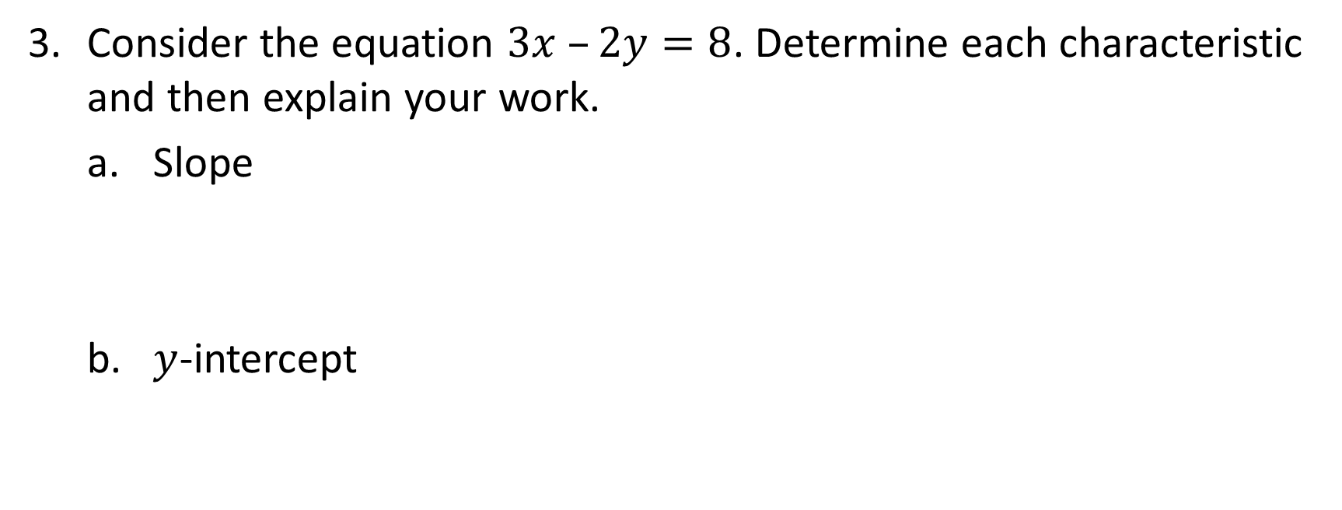
Equations in Different Forms (5 of 13)
Consider the equation $3x –2y=8$. Determine each characteristic and then explain your work.
Slope
  3/2
b. $y$-intercept
  (0, −4)
★ Essential · SE p. 360
18
Notes:
Questions to Support Discourse – Probing:
How did you identify the intercepts? The slope?
Which characteristics of the graph are obvious when the equation is written in this form?

Slide 19
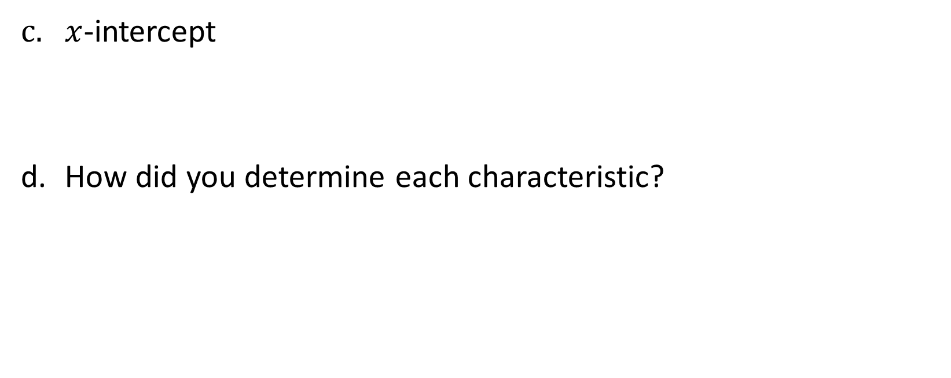
Equations in Different Forms (6 of 13)
$x$-intercept
  (8/3, 0)
How did you determine each characteristic?
  Rewrite in slope-intercept form, y = (3/2)x − 4, for the slope and y-intercept. Substitute 0 for y for the x-intercept.
★ Essential · SE p. 360
19
Notes:
Questions to Support Discourse – Probing:
How did you identify the intercepts? The slope?
Which characteristics of the graph are obvious when the equation is written in this form?

Slide 20
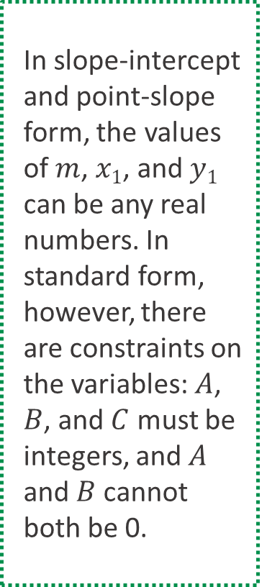
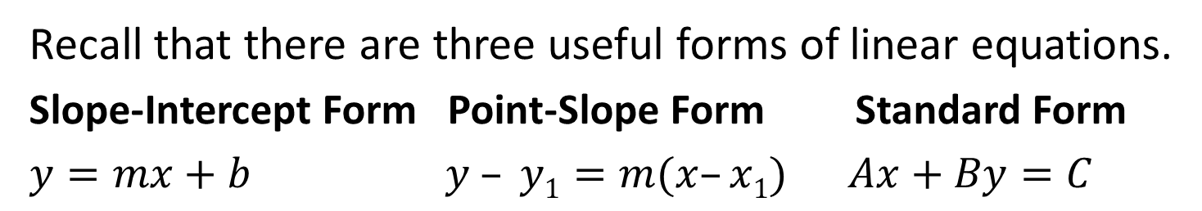
Equations in Different Forms (7 of 13)
In slope-intercept and point-slope form, the values of $m$, $x1$, and $y1$ can be any real numbers. In standard form, however, there are constraints on the variables: $A$, $B$, and $C$ must be integers, and $A$ and $B$ cannot both be 0.
Recall that there are three useful forms of linear equations.
Slope-Intercept Form Point-Slope Form Standard Form
$y=mx+b$ $y – y1=m(x–x1)$ $Ax+By=C$
Identify the form for each equation in Questions 1 through 3.
  Q1: slope-intercept form. Q2: point-slope form. Q3: standard form.
★ Essential · SE p. 360
20
Notes:
Questions to Support Discourse – Seeing Structure:
What do slope-intercept form and point-slope form have in common?
Which form can you also refer to as the slope-intercept form? Why?
How can you easily identify the point-slope form of a linear equation?
Describe the structure of a linear equation in standard form.

Slide 21
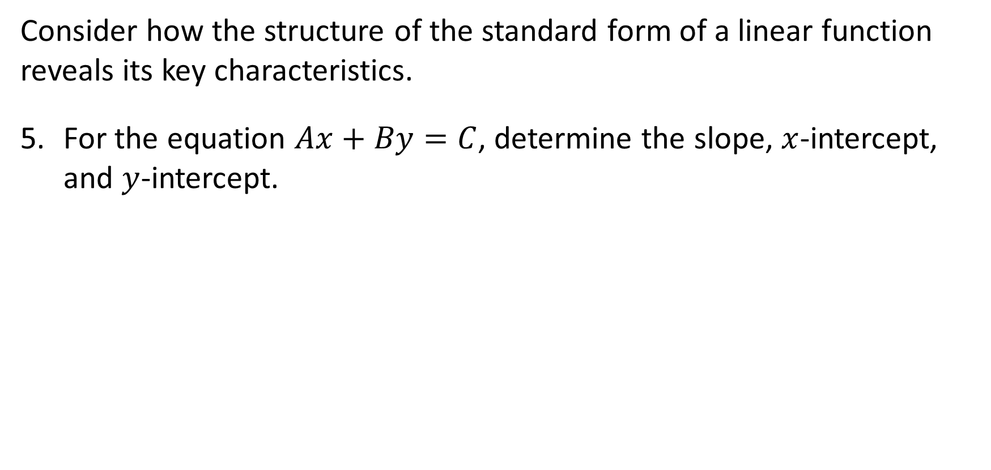
Equations in Different Forms (8 of 13)
Consider how the structure of the standard form of a linear function reveals its key characteristics.
For the equation $Ax+By=C$, determine the slope, $x$-intercept, and $y$-intercept.
  Slope −A/B; x-intercept (C/A, 0); y-intercept (0, C/B)
★ Essential · SE p. 360
21
Notes:
Questions to Support Discourse – Probing:
Show how you applied the same thinking you used in Question 3 to solve for these characteristics.
How can you identify the slope and x-intercept from point-slope form?
Questions to Support Discourse – Reflecting and Justifying:
For any of these purposes, are there multiple forms of the equation that are equally efficient? Explain your reasoning.
Which form do you prefer to start with when rewriting an equation in slope-intercept form? point-slope form? standard form?

Slide 22
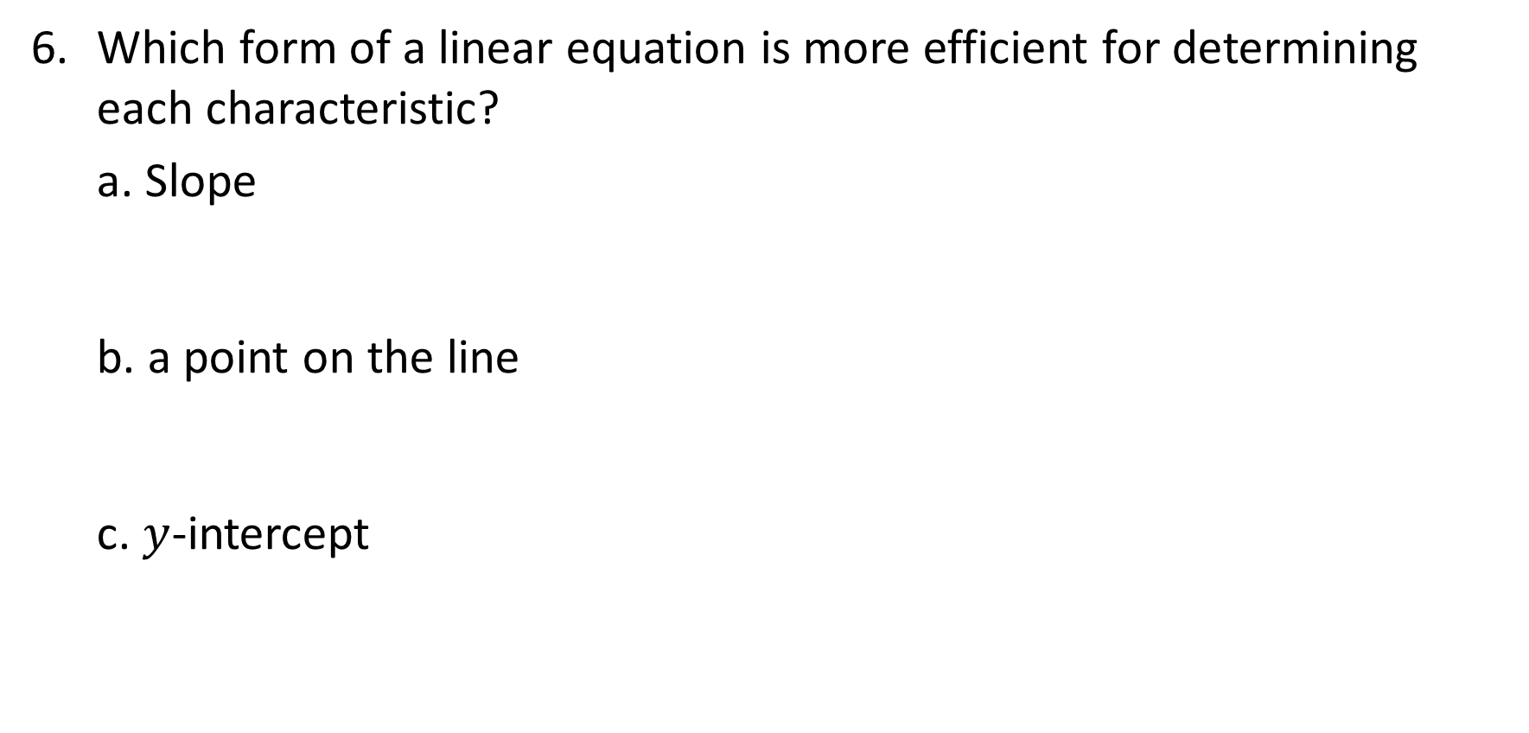
Equations in Different Forms (9 of 13)
Which form of a linear equation is more efficient for determining each characteristic?
Slope
  slope-intercept form or point-slope form
a point on the line
  point-slope form
$y$-intercept
  slope-intercept form
★ Essential · SE p. 361
22
Notes:
Questions to Support Discourse – Probing:
Show how you applied the same thinking you used in Question 3 to solve for these characteristics.
How can you identify the slope and x-intercept from point-slope form?
Questions to Support Discourse – Reflecting and Justifying:
For any of these purposes, are there multiple forms of the equation that are equally efficient? Explain your reasoning.
Which form do you prefer to start with when rewriting an equation in slope-intercept form? point-slope form? standard form?

Slide 23
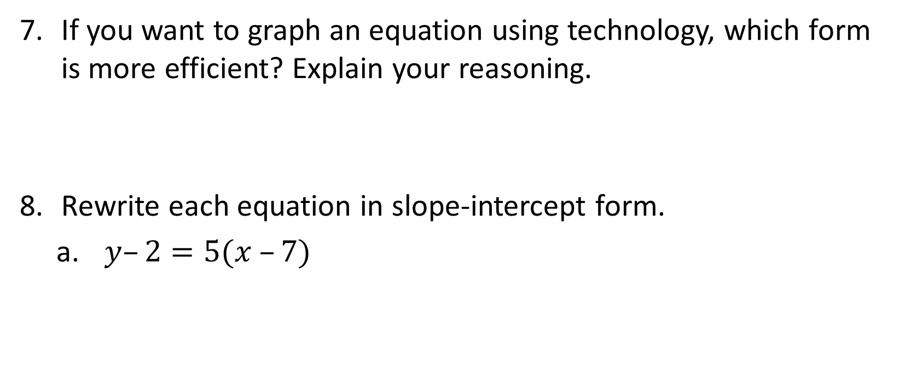
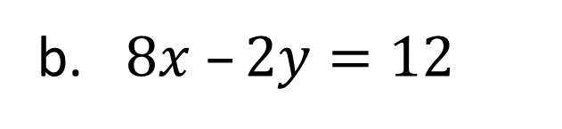
Equations in Different Forms (10 of 13)
If you want to graph an equation using technology, which form is more efficient? Explain your reasoning.
  Slope-intercept form: graphing technology takes y = … directly.
Rewrite each equation in slope-intercept form.
  $y–2=5(x –7)$
    y = 5x − 33
$8x –2y=12$
  y = 4x − 6
★ Essential · SE p. 361
23
Notes:
Questions to Support Discourse – Probing:
Show how you applied the same thinking you used in Question 3 to solve for these characteristics.
How can you identify the slope and x-intercept from point-slope form?
Questions to Support Discourse – Reflecting and Justifying:
For any of these purposes, are there multiple forms of the equation that are equally efficient? Explain your reasoning.
Which form do you prefer to start with when rewriting an equation in slope-intercept form? point-slope form? standard form?

Slide 24
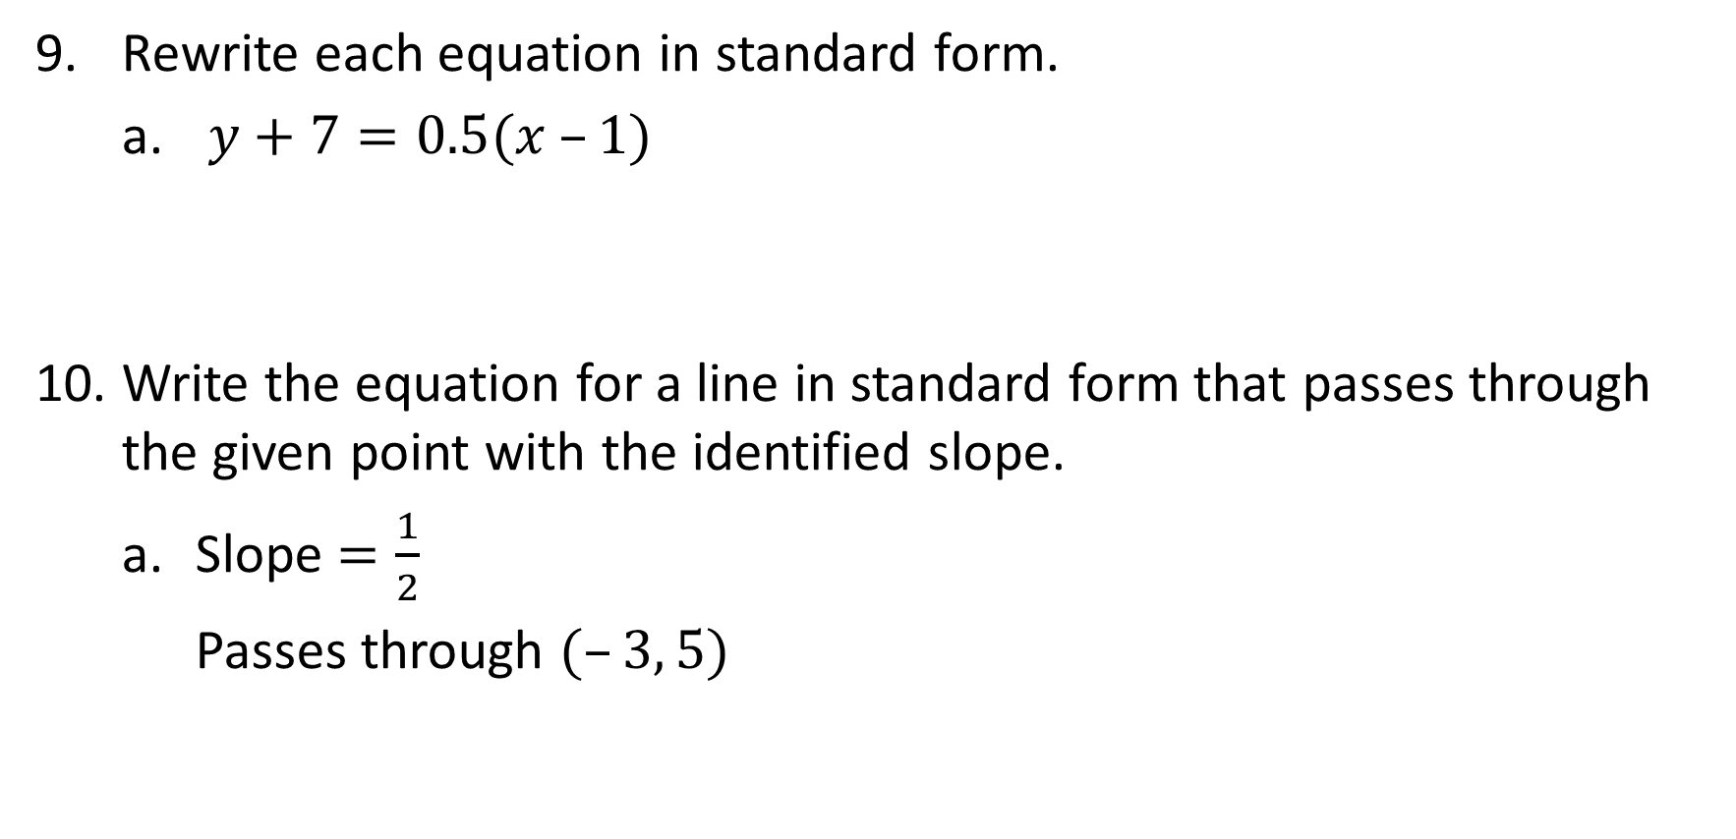
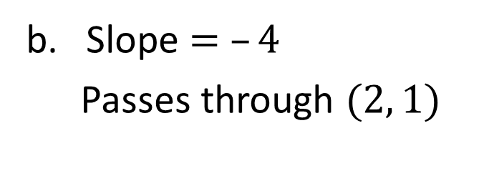
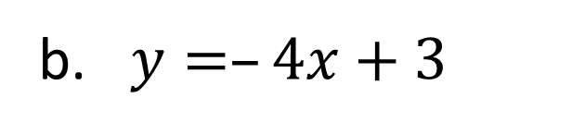
Equations in Different Forms (11 of 13)
9. Rewrite each equation in standard form.
  $y+7=0.5(x –1)$
    x − 2y = 15
Write the equation for a line in standard form that passes through the given point with the identified slope.
  Slope $=\frac{1}{2}$
  Passes through $(–3, 5)$
    x − 2y = −13
$y=–4x+3$
  4x + y = 3
Slope $= –4$
Passes through $(2, 1)$
  4x + y = 9
★ Essential · SE p. 361
24
Notes:
Questions to Support Discourse – Probing:
Show how you applied the same thinking you used in Question 3 to solve for these characteristics.
How can you identify the slope and x-intercept from point-slope form?
Questions to Support Discourse – Reflecting and Justifying:
For any of these purposes, are there multiple forms of the equation that are equally efficient? Explain your reasoning.
Which form do you prefer to start with when rewriting an equation in slope-intercept form? point-slope form? standard form?
TE correction: the TE gives x − 2y = −7 and 4x + y = 7. With slope 1/2 through (−3, 5): y − 5 = ½(x + 3), so x − 2y = −13. With slope −4 through (2, 1): y − 1 = −4(x − 2), so y = −4x + 9 and 4x + y = 9.

Slide 25
Equations in Different Forms (12 of 13)
Let’s revisit the Essential Question and summarize our learning from Activity 2.1!
Essential Question: How can you use those same properties to solve for one specific variable in an equation that has multiple variables?
★ Essential · SE p. 361
25
Notes:
Note: To close Day 1 session, have students reread the Essential Question and read the activity summaries to the class.
Activity 2.1 Summary:
Slope-intercept form of a linear equation is the most useful form to identify the slope and y-intercept. Point-slope form of a linear equation is the most useful form to identify the slope and a point on the line.

Slide 26
Equations in Different Forms (13 of 13)
★ Essential · SE p. 361
26
Notes:
Note: This slide is blank for optional use with displaying work.

Slide 27
Day 2
2
27
Notes:
Note: Total suggested pacing for Day 2 is 45 minutes.

Slide 28
Essential Question (2 of 2)
How can you use those same properties to solve for one specific variable in an equation that has multiple variables?
SE p. 357
28
Notes:
Note: To begin Day 2, have a student read the Essential Question aloud.

Slide 29
Activity 2.2
★ Essential activity: do not skip
2.2
15–20
29
Notes:
Note: Total time of 15-20 minutes allotted for Activity 2.2.

Slide 30
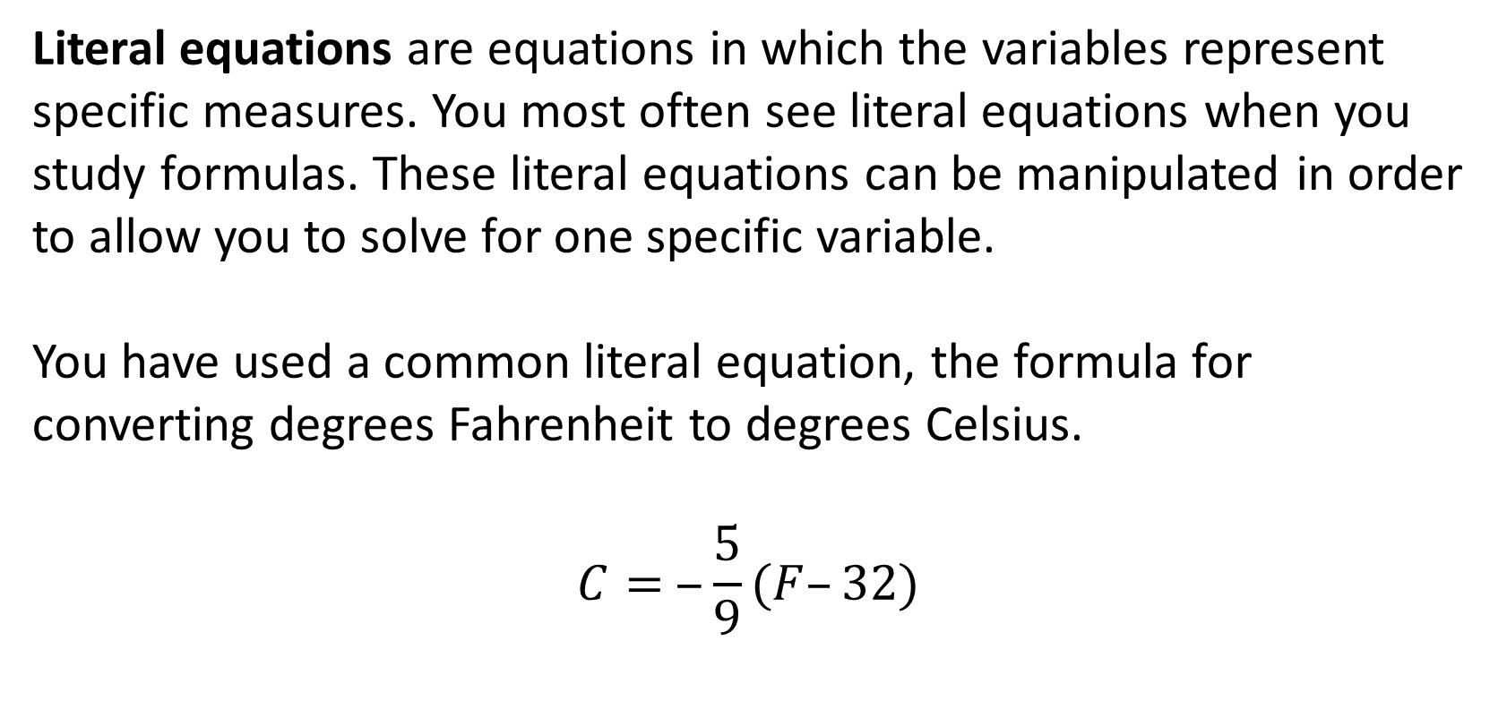
Rewriting Literal Equations (1 of 11)
Literal equations are equations in which the variables represent
specific measures. You most often see literal equations when you study formulas. These literal equations can be manipulated in order to allow you to solve for one specific variable.
You have used a common literal equation, the formula for converting degrees Fahrenheit to degrees Celsius.
$$C= ‒\frac{5}{9}(F–32)$$
★ Essential · SE p. 362
30
Notes:
Questions to Support Discourse – Gathering:
What part of the world measures temperatures using degrees Celsius? Degrees Fahrenheit?
Questions to Support Discourse – Seeing Structure:
How can you tell whether an equation is set up to convert from Celsius to Fahrenheit or Fahrenheit to Celsius?
Slide typo: the formula shows C = −5/9(F − 32). It is C = 5/9(F − 32), as on slide 38 and in the Student Edition.

Slide 31
Rewriting Literal Equations (2 of 11)
Jayden is talking on the phone to his friend Mateo who lives in Europe. Mateo is used to describing temperatures in °C, while Jayden is used to describing temperatures in °F. Mateo can use the formula above to quickly convert the temperatures Jayden describes to °C.
★ Essential · SE p. 362
31
Notes:
Questions to Support Discourse – Gathering:
What part of the world measures temperatures using degrees Celsius? Degrees Fahrenheit?
Questions to Support Discourse – Seeing Structure:
How can you tell whether an equation is set up to convert from Celsius to Fahrenheit or Fahrenheit to Celsius?

Slide 32
Rewriting Literal Equations (3 of 11)
How can you rewrite the formula so that Jayden can quickly convert the temperatures that Mateo describes to °F? Justify your solution method.
  Multiply both sides by 9/5: (9/5)C = F − 32. Add 32 to both sides: F = (9/5)C + 32.
★ Essential · SE p. 362
32
Notes:
Questions to Support Discourse – Probing:
Explain how you solved for F. What is another way?
What would Jayden’s steps be if he substituted 77 in the original formula?
Which method do you prefer, substituting the 77 in the original formula and solving the equation or isolating F first and using substitution? Why?
Why did Isabella multiply both sides by 9?
Which term did Isabella add to both sides?
Compare your strategy to Isabella’s strategy.
Explain the difference in the errors Ethan and Minh made when using the distributive property.
Questions to Support Discourse – Seeing Structure:
Explain how the rewritten formula relates to the original formula.
Questions to Support Discourse – Gathering:
Which property did Isabella apply first?

Slide 33

Rewriting Literal Equations (4 of 11)
Jayden tells Mateo that the temperature where he lives is currently 77°F. Mateo tells Jayden that the temperature where he lives is currently 30°C. Jayden says it is warmer where he lives and Mateo says it is warmer where he lives. Who is correct? Explain your reasoning.
  Mateo is correct: 30°C = (9/5)(30) + 32 = 86°F, which is warmer than 77°F (77°F = 25°C).
★ Essential · SE p. 362
33
Notes:
Questions to Support Discourse – Probing:
Explain how you solved for F. What is another way?
What would Jayden’s steps be if he substituted 77 in the original formula?
Which method do you prefer, substituting the 77 in the original formula and solving the equation or isolating F first and using substitution? Why?
Why did Isabella multiply both sides by 9?
Which term did Isabella add to both sides?
Compare your strategy to Isabella’s strategy.
Explain the difference in the errors Ethan and Minh made when using the distributive property.
Questions to Support Discourse – Seeing Structure:
Explain how the rewritten formula relates to the original formula.
Questions to Support Discourse – Gathering:
Which property did Isabella apply first?

Slide 34
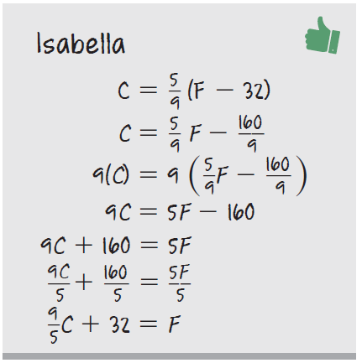
Rewriting Literal Equations (5 of 11)
Isabella, Ethan, and Minh each convert the given formula to degrees Fahrenheit.
Explain Isabella’s reasoning.
  She distributed 5/9, multiplied both sides by 9, added 160, then divided by 5: F = (9/5)C + 32.
★ Essential · SE p. 363
34
Notes:
Questions to Support Discourse – Probing:
Explain how you solved for F. What is another way?
What would Jayden’s steps be if he substituted 77 in the original formula?
Which method do you prefer, substituting the 77 in the original formula and solving the equation or isolating F first and using substitution? Why?
Why did Isabella multiply both sides by 9?
Which term did Isabella add to both sides?
Compare your strategy to Isabella’s strategy.
Explain the difference in the errors Ethan and Minh made when using the distributive property.
Questions to Support Discourse – Seeing Structure:
Explain how the rewritten formula relates to the original formula.
Questions to Support Discourse – Gathering:
Which property did Isabella apply first?

Slide 35
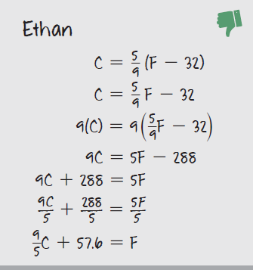
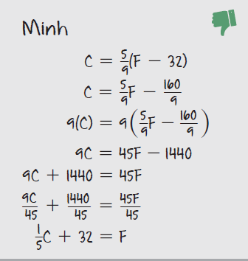
Rewriting Literal Equations (6 of 11)
★ Essential · SE p. 363
35
Notes:
Questions to Support Discourse – Probing:
Explain how you solved for F. What is another way?
What would Jayden’s steps be if he substituted 77 in the original formula?
Which method do you prefer, substituting the 77 in the original formula and solving the equation or isolating F first and using substitution? Why?
Why did Isabella multiply both sides by 9?
Which term did Isabella add to both sides?
Compare your strategy to Isabella’s strategy.
Explain the difference in the errors Ethan and Minh made when using the distributive property.
Questions to Support Discourse – Seeing Structure:
Explain how the rewritten formula relates to the original formula.
Questions to Support Discourse – Gathering:
Which property did Isabella apply first?

Slide 36
Rewriting Literal Equations (7 of 11)
Explain the error in Ethan’s work.
  In line 2 he did not distribute 5/9 to the 32.
Explain the error in Minh’s work.
  He multiplied by 9 wrong: 9 · (5/9)F = 5F (not 45F) and 9 · (160/9) = 160 (not 1440).
★ Essential · SE p. 363
36
Notes:
Questions to Support Discourse – Probing:
Explain how you solved for F. What is another way?
What would Jayden’s steps be if he substituted 77 in the original formula?
Which method do you prefer, substituting the 77 in the original formula and solving the equation or isolating F first and using substitution? Why?
Why did Isabella multiply both sides by 9?
Which term did Isabella add to both sides?
Compare your strategy to Isabella’s strategy.
Explain the difference in the errors Ethan and Minh made when using the distributive property.
Questions to Support Discourse – Seeing Structure:
Explain how the rewritten formula relates to the original formula.
Questions to Support Discourse – Gathering:
Which property did Isabella apply first?

Slide 37

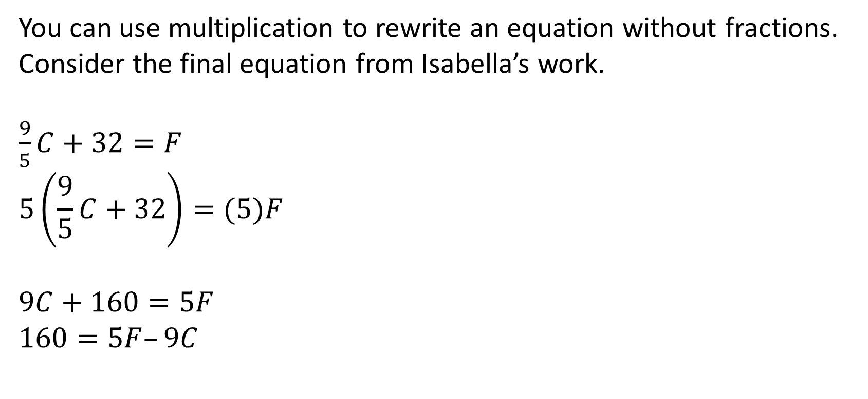
Rewriting Literal Equations (8 of 11)
You can use multiplication to rewrite an equation without fractions.
Consider the final equation from Isabella’s work.
$\frac{9}{5}C+32=F$
$$5\left(\frac{9}{5}C+32\right)=(5)F$$
$$9C+160=5F$$
$$160=5F–9C$$
Multiply both sides of the equation by 5 to
eliminate the fraction.
Subtract 9C from both sides of the equation.
★ Essential · SE p. 364
37

Slide 38
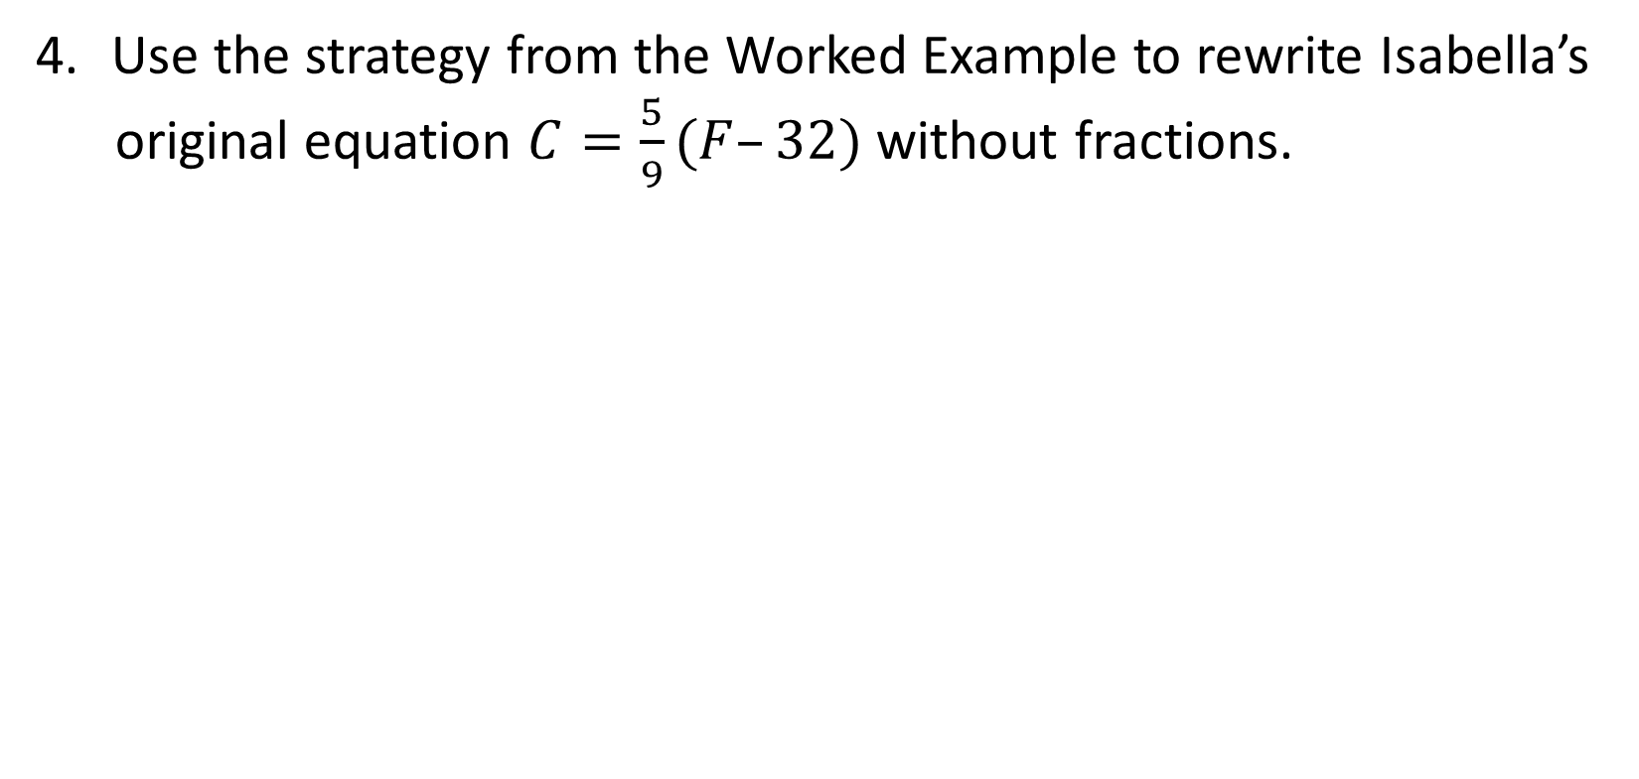
Rewriting Literal Equations (9 of 11)
Use the strategy from the Worked Example to rewrite Isabella’s
original equation $C=\frac{5}{9}(F–32)$ without fractions.
  9C = 5(F − 32) → 9C = 5F − 160 → 9C − 5F = −160
★ Essential · SE p. 364
38
Notes:
Questions to Support Discourse – Gathering:
Determine the forms of the equations.
What is the form of this equation?
Questions to Support Discourse – Probing:
Are the equations in the Worked Example and what you wrote in Question 4 equivalent?

Slide 39
Rewriting Literal Equations (10 of 11)
Let’s summarize our learning from Activity 2.2!
★ Essential · SE p. 364
39
Notes:
Activity 2.2 Summary:
A formula that includes more than one variable may be rewritten to isolate a different variable in the formula for efficiency in solving problems.

Slide 40
Rewriting Literal Equations (11 of 11)
★ Essential · SE p. 364
40
Notes:
Note: This slide is blank for optional use with displaying work.

Slide 41
Activity 2.3
★ Essential activity: do not skip
2.3
15–20
41
Notes:
Note: Total time of 15-20 minutes allotted for Activity 2.3.

Slide 42
Solving Literal Equations for Specific Variables (1 of 8)
Convert each literal equation to solve for the given variable.
Think Inside the Box is manufacturing new boxes for Pack-n-Ship. Pack-n-Ship told Think Inside the Box that the boxes must have a specific volume and area of the base. However, Pack-n-Ship did not specify a height for the boxes.
Remember…
Volume is measured in cubic units since it’s calculated using three dimensions.
Height measures only one dimension.
★ Essential · SE p. 365
42
Notes:
Questions to Support Discourse – Probing:
Explain how you solved for h.
What variables represent the area of the base?
How did you solve for h?
What is the result of $\frac{units3}{units2}$?
Questions to Support Discourse – Gathering:
What are the units for the volume?

Slide 43
Solving Literal Equations for Specific Variables (2 of 8)
Write a literal equation to calculate the volume of a box. Then,
convert the volume formula to solve for height.
  V = Bh, so h = V/B
Pack-n-Ship specified the volume of the box must be 450 cubic
inches and the area of the base must be 75 square inches. Use
your formula to determine the height of the new boxes.
  h = 450 ÷ 75 = 6 inches
★ Essential · SE p. 365
43
Notes:
Questions to Support Discourse – Probing:
Explain how you solved for h.
What variables represent the area of the base?
How did you solve for h?
What is the result of $\frac{units3}{units2}$?
Questions to Support Discourse – Gathering:
What are the units for the volume?

Slide 44
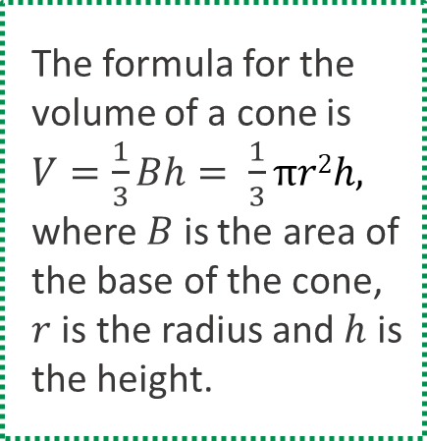
Solving Literal Equations for Specific Variables (3 of 8)
The volume of an ice cream cone is the measure
of how much ice cream fits inside the cone. An ice cream cone company wants to make an ice cream cone with a greater height that still holds the same amount of ice cream.
  Write an equation to calculate the volume of a cone. Then, convert the equation to solve for the height.
    V = (1/3)πr²h, so h = 3V/(πr²)
The formula for the
volume of a cone is $V=\frac{1}{3}Bh= \frac{1}{3}πr2h,$
where $B$ is the area of
the base of the cone,
$r$ is the radius and $h$ is
the height.
★ Essential · SE p. 365
44
Notes:
Questions to Support Discourse – Probing:
Explain how you solved for h.
What variables represent the area of the base?
How did you solve for h?
What is the result of $\frac{units3}{units2}$?
Questions to Support Discourse – Gathering:
What are the units for the volume?

Slide 45
Solving Literal Equations for Specific Variables (4 of 8)
Explain how your equation determines a linear measurement when the original equation determined a cubic measurement.
  Volume (cubic units) divided by the base area (square units, r · r) leaves a linear unit for the height.
★ Essential · SE p. 365
45
Notes:
Questions to Support Discourse – Probing:
Explain how you solved for h.
What variables represent the area of the base?
How did you solve for h?
What is the result of $\frac{units3}{units2}$?
Questions to Support Discourse – Gathering:
What are the units for the volume?

Slide 46
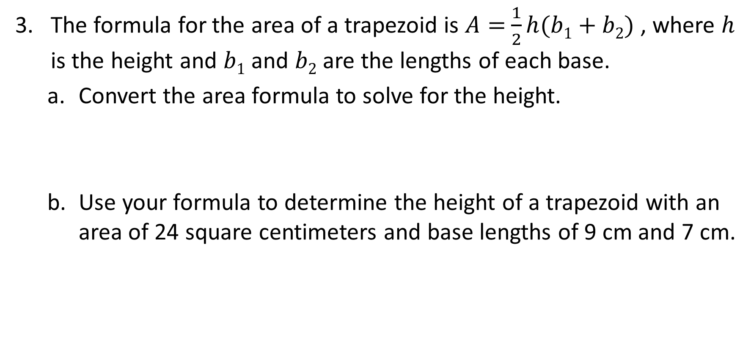
Solving Literal Equations for Specific Variables (5 of 8)
The formula for the area of a trapezoid is $A=$ $\frac{1}{2}h(b1+b2)$ , where $h$ is the height and $b1$ and $b2$ are the lengths of each base.
Convert the area formula to solve for the height.
  h = 2A/(b₁ + b₂)
Use your formula to determine the height of a trapezoid with an area of 24 square centimeters and base lengths of 9 cm and 7 cm.
  h = 2(24)/(9 + 7) = 48/16 = 3 cm
★ Essential · SE p. 366
46
Notes:
Questions to Support Discourse – Probing:
Did you apply the distributive property to solve for h?
How could you solve for h without applying the distributive property?

Slide 47
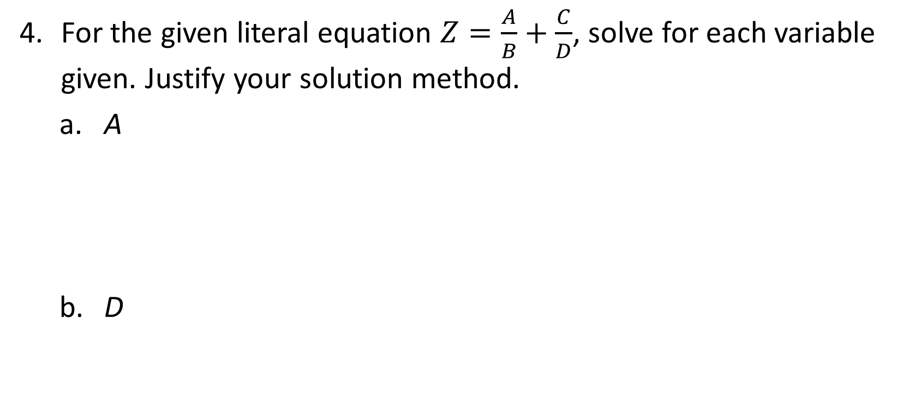
Solving Literal Equations for Specific Variables (6 of 8)
For the given literal equation $Z=\frac{A}{B}+\frac{C}{D}$, solve for each variable given. Justify your solution method.
  A
    A = BZ − BC/D: multiply both sides by B, then subtract BC/D.
  D
    D = BC/(BZ − A): multiply by BD, move the D terms to one side, factor out D, divide by BZ − A.
★ Essential · SE p. 366
47
Notes:
Questions to Support Discourse – Probing:
What is another way to express the equation in part (a)?
What operation did you use so that D was no longer in the denominator?

Slide 48
Solving Literal Equations for Specific Variables (7 of 8)
Let’s summarize our learning from Activity 2.3!
★ Essential · SE p. 366
48
Notes:
Activity 2.3 Summary:
A formula that includes more than one variable may be rewritten to isolate any variable contained in the formula by applying properties of equality and number properties.

Slide 49
Solving Literal Equations for Specific Variables (8 of 8)
★ Essential · SE p. 366
49
Notes:
Note: This slide is blank for optional use with displaying work.

Slide 50
Talk the Talk
★ Essential activity: do not skip
5–10
50
Notes:
Note: Total time of 5-10 minutes allotted for the Talk the Talk.

Slide 51
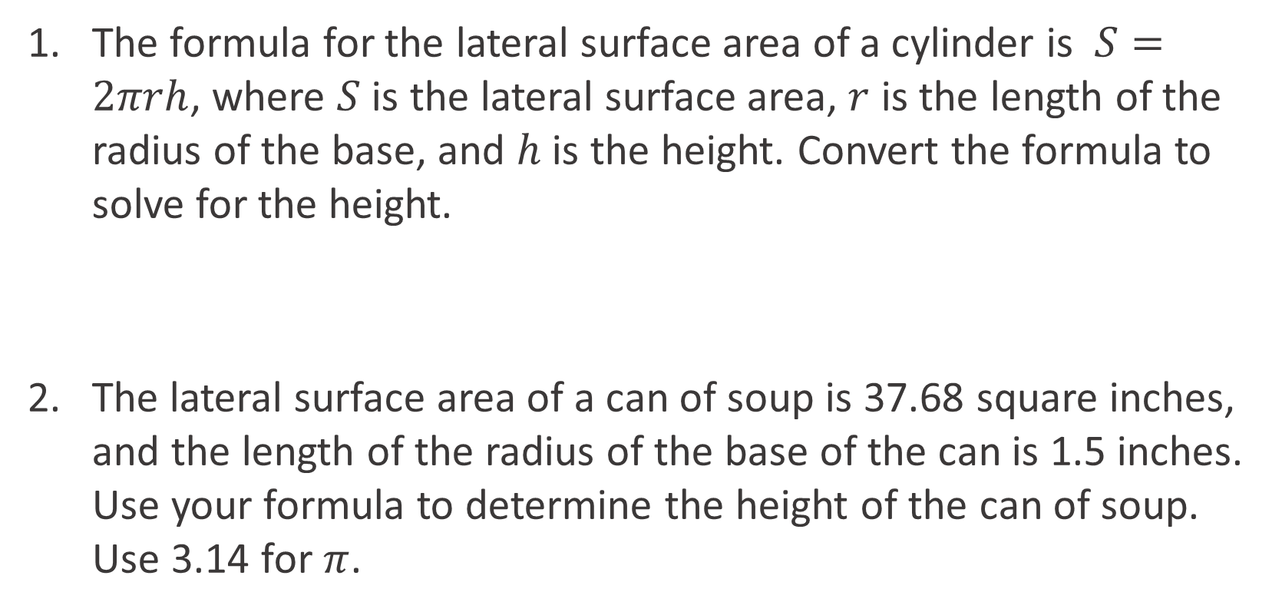
Rearrange It (1 of 4)
The formula for the lateral surface area of a cylinder is $S=2πrh$, where $S$ is the lateral surface area, $r$ is the length of the radius of the base, and $h$ is the height. Convert the formula to solve for the height.
  h = S/(2πr)
The lateral surface area of a can of soup is 37.68 square inches, and the length of the radius of the base of the can is 1.5 inches. Use your formula to determine the height of the can of soup. Use 3.14 for $π$.
  h = 37.68 ÷ (2 · 3.14 · 1.5) = 37.68 ÷ 9.42 = 4 in.
★ Essential · SE p. 367
51
Notes:
Questions to Support Discourse – Probing:
What is the most efficient way to solve for h?
Why is it easier to use your response in Question 1 rather than the original formula to calculate the value of h?
Questions to Support Discourse – Seeing Structure:
What is the relationship between your steps to solve the equation in Question 3 and those to solve a twostep equation?
Would you rather substitute the value of h in the original formula and then solve the resulting equation or solve the literal equation first and then evaluate the resulting expression? Why?

Slide 52
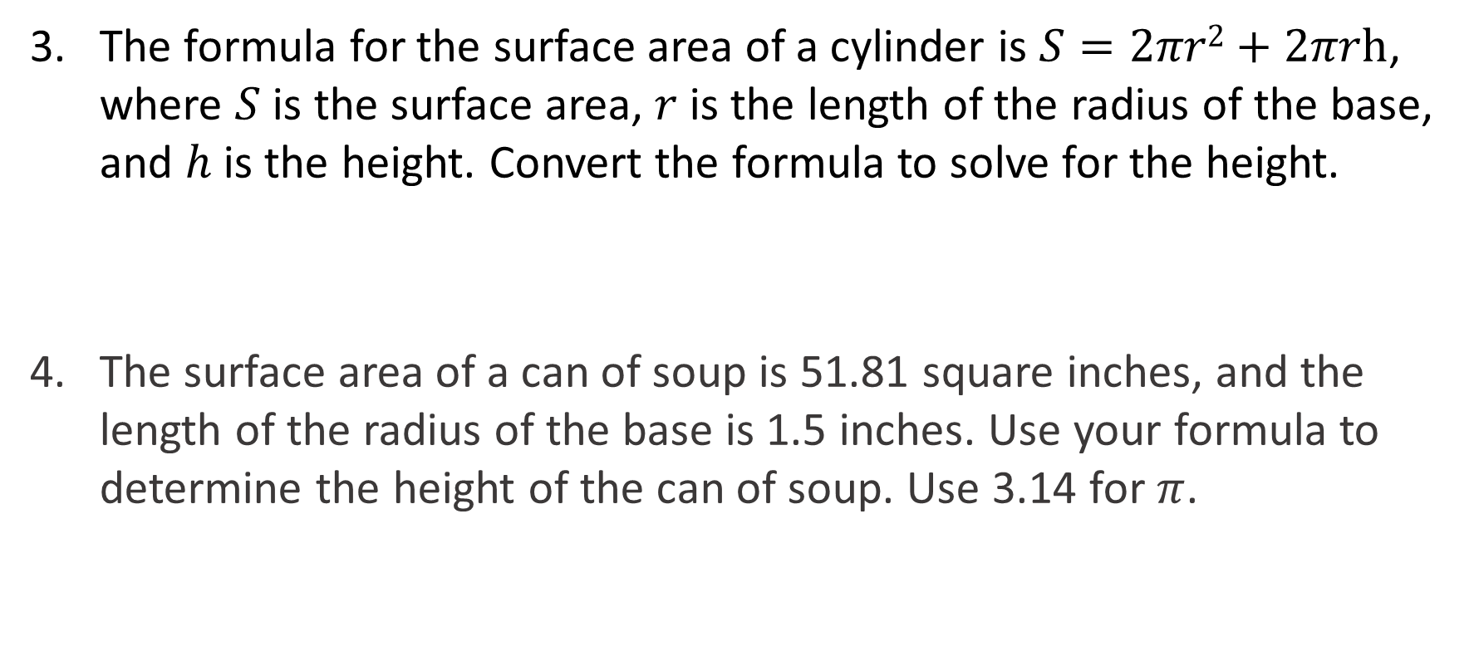
Rearrange It (2 of 4)
The formula for the surface area of a cylinder is $S=2πr2+2πrh$, where $S$ is the surface area, $r$ is the length of the radius of the base, and $h$ is the height. Convert the formula to solve for the height.
  h = (S − 2πr²)/(2πr)
The surface area of a can of soup is 51.81 square inches, and the length of the radius of the base is 1.5 inches. Use your formula to determine the height of the can of soup. Use 3.14 for $π$.
  h = (51.81 − 14.13) ÷ 9.42 = 4 in.
★ Essential · SE p. 367
52
Notes:
Questions to Support Discourse – Probing:
What is the most efficient way to solve for h?
Why is it easier to use your response in Question 1 rather than the original formula to calculate the value of h?
Questions to Support Discourse – Seeing Structure:
What is the relationship between your steps to solve the equation in Question 3 and those to solve a twostep equation?
Would you rather substitute the value of h in the original formula and then solve the resulting equation or solve the literal equation first and then evaluate the resulting expression? Why?

Slide 53
Rearrange It (3 of 4)
Let’s answer the Essential Question and summarize our learning from the Talk the Talk!
Essential Question: How can you use those same properties to solve for one specific variable in an equation that has multiple variables?
  Use the same properties of equality to isolate that one variable, treating every other letter like a number.
★ Essential · SE p. 367
53
Notes:
Note: To close Day 2, have students read and answer the Essential Question and then read the Stamp the Learning summary aloud.
Essential Question:
Sample answer: I can use the properties to isolate one specific variable on one side of the equation with all other terms on the other side.
Talk the Talk Summary:
A formula that includes more than one variable may be rewritten to isolate any variable contained in the formula by applying properties of equality and number properties.

Slide 54
Rearrange It (4 of 4)
★ Essential · SE p. 367
54
Notes:
Note: This slide is blank for optional use with displaying work.

Slide 55
Prepare
55
Notes:
How can you identify whether students are ready for new learning? ​
Depending on available time, you can assign the Prepare section of the Lesson Assignments as homework or as a warm-up to identify students' prior knowledge for the upcoming lesson's activities.

Slide 56
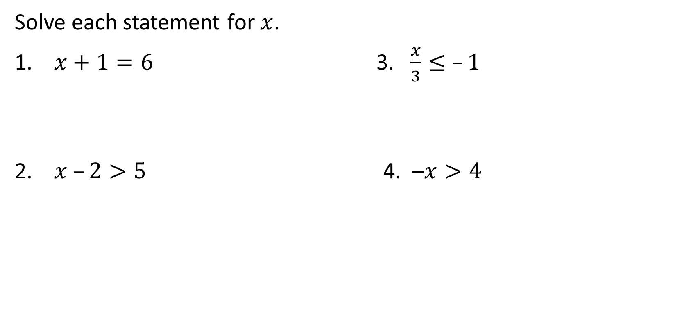
Prepare for Module 3 Topic 1 Lesson 3
Solve each statement for $x$.
$x+1=6$ 3. $\frac{x}{3}≤ –1$
$x –2>5$ 4. –$x>4$
x = 5
x ≤ −3
x > 7
x < −4
SE p. 370
56

Slide 57
Teacher Edition and slide corrections for this deck
• Activity 2.1 Q10a (slope 1/2 through (−3, 5)): x − 2y = −13, not −7 as the TE says.
• Activity 2.1 Q10b (slope −4 through (2, 1)): 4x + y = 9, not 7 as the TE says.
• Slide 30: the formula has a stray minus sign; it is C = 5/9(F − 32).
• Every other TE answer was re-solved and is correct.
57

Slide 58
Acknowledgment and Notice
58

Slide 59
BLMathematics_AlgI_M3_T1_L2_LessonSlides_ENG_2025
59

